Slide 1
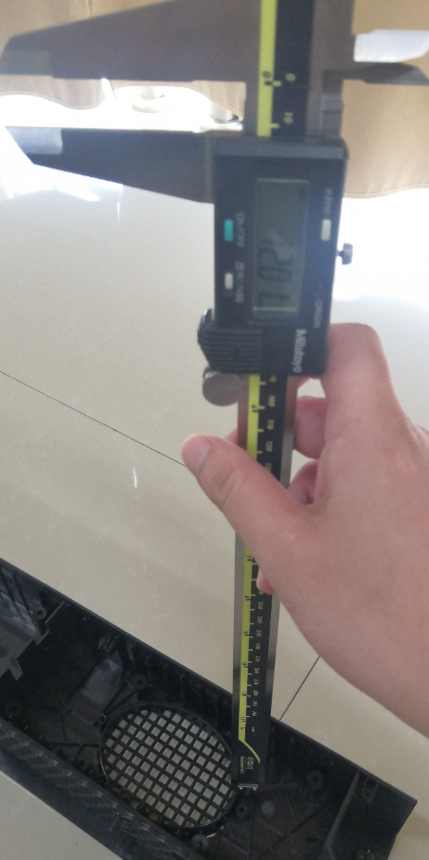
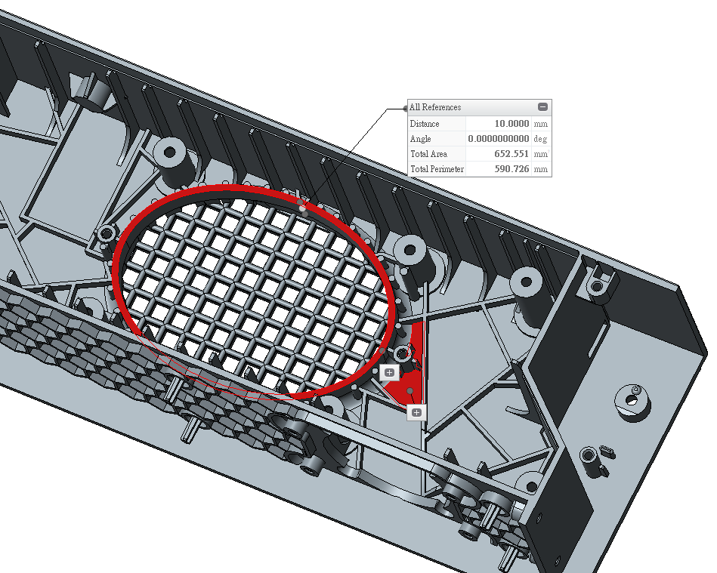
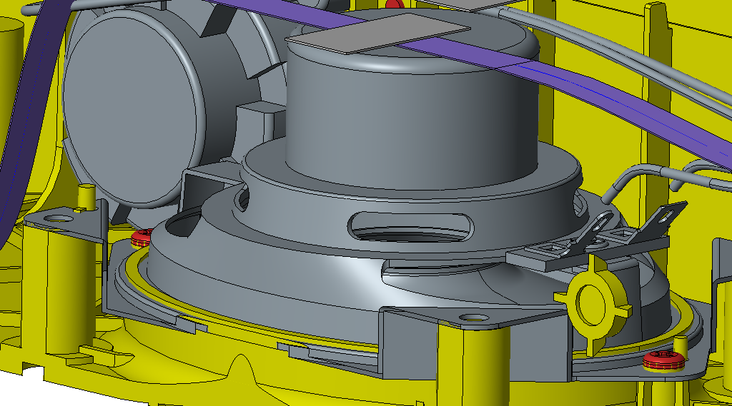
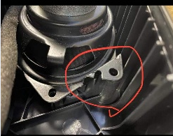
Housing sample
The rib height of the received sample is 12mm, but the dimension in 3D is 10mm. The speaker will interference with bottom cover so that it can not be assembled.
3D on March 30th
Assembly issue
Speaker
Bottom cover
Interference

Slide 2
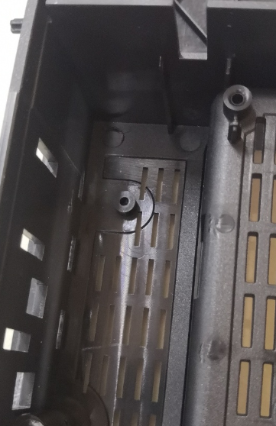
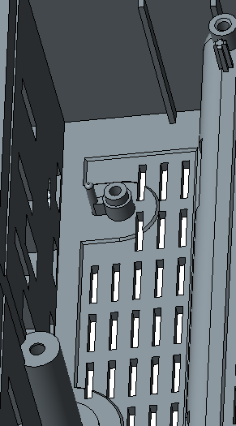
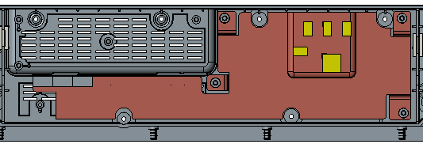
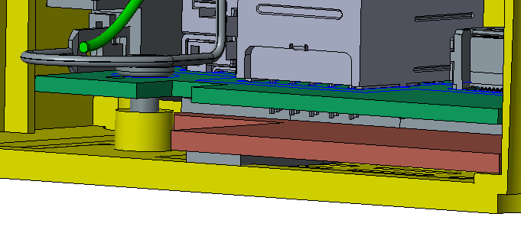
Housing sample
3D on March 30th
The SoC board can not touch the fix-boss with Heatspreader for DVT3.
Assembly issue
SoC board
Bottom cover
Heatspreader for DVT3

